Slide 1

House Price project
Submitted By- Madhurima Srivastava Batch no-1843(internship 30)

Slide 2
Project – problem statement
A US bases company wants to enter in Australian real estate market. Company uses data analysis Currently to buy property and sell at high price. They have decided to build a machine learning model for the same and in the same context they have collected some data point in the csv file.
Basis on collected data, a machine learning model to be built and need below important things to be revealed.
1. Which variables are important to predict the price of variable?
2. How do these variables describe the price of the house?
Once model is built, it will be used by the management to see how prices vary with the variables so that we can make their strategy and make profit. Model will also make them help to understand the market dynamics.

Slide 3
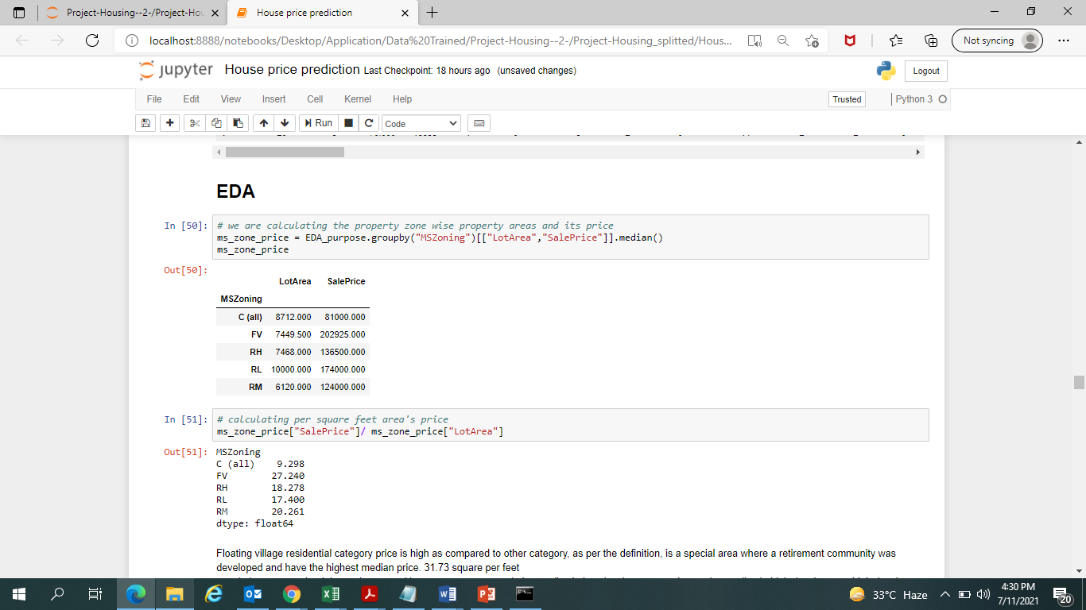
EDA Steps & Visualization
Floating village residential category price is high as compared to other category, as per the definition, is a special area where a retirement community was developed and have the highest median price. 31.73 square per feet people loves peace but it is not the case with everyone ,some people love to live in low density areas and some love to live in high density area. high density area, i am assuming that everything which is necessary for daily life is easily available as compared to low density area and prices are also define accordingly, by nature if everything is accessible easily prices will be high for that place. we can see the same affect here in data as well. Average RH price per square feet is 18.27 and for RL is 17.40 per square feet. we see that RM price is high as compared to RH considering several factor like easy access to things, low noise population, low air population, less crowd etc.

Slide 4
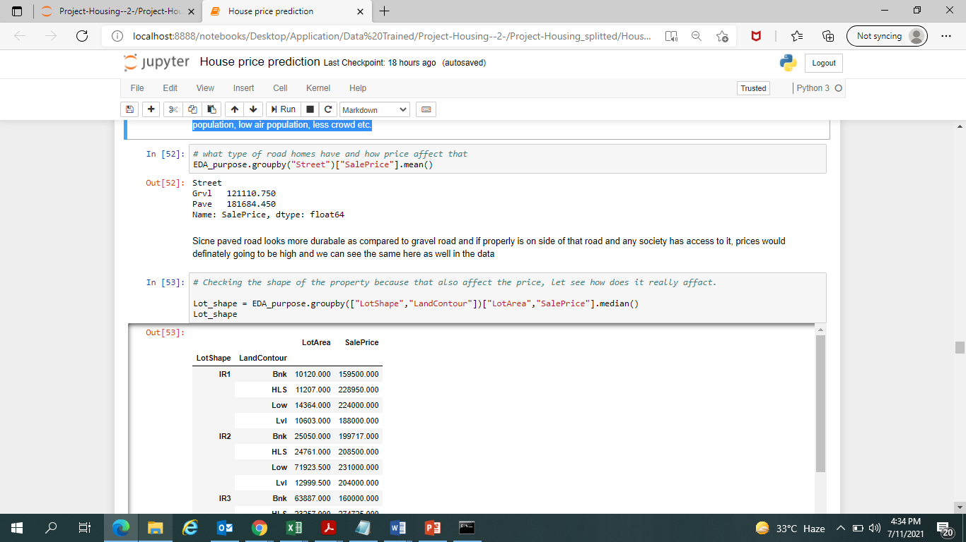
EDA Steps & Visualization
Since paved road looks more durable as compared to gravel road and if properly is on side of that road and any society has access to it, prices would definitely going to be high and we can see the same here as well in the data

Slide 5
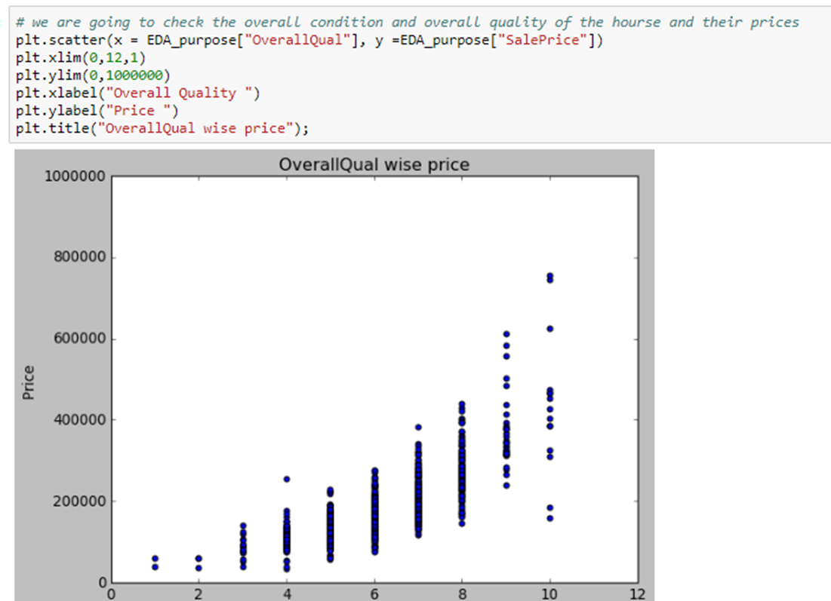
EDA Steps & Visualization
we can see that price are varying as per the overall quality of material used for building it. it depends on the lot also and we see that it has gone to $800000 . Same way we will check the overall condition of the house and relate with price

Slide 6
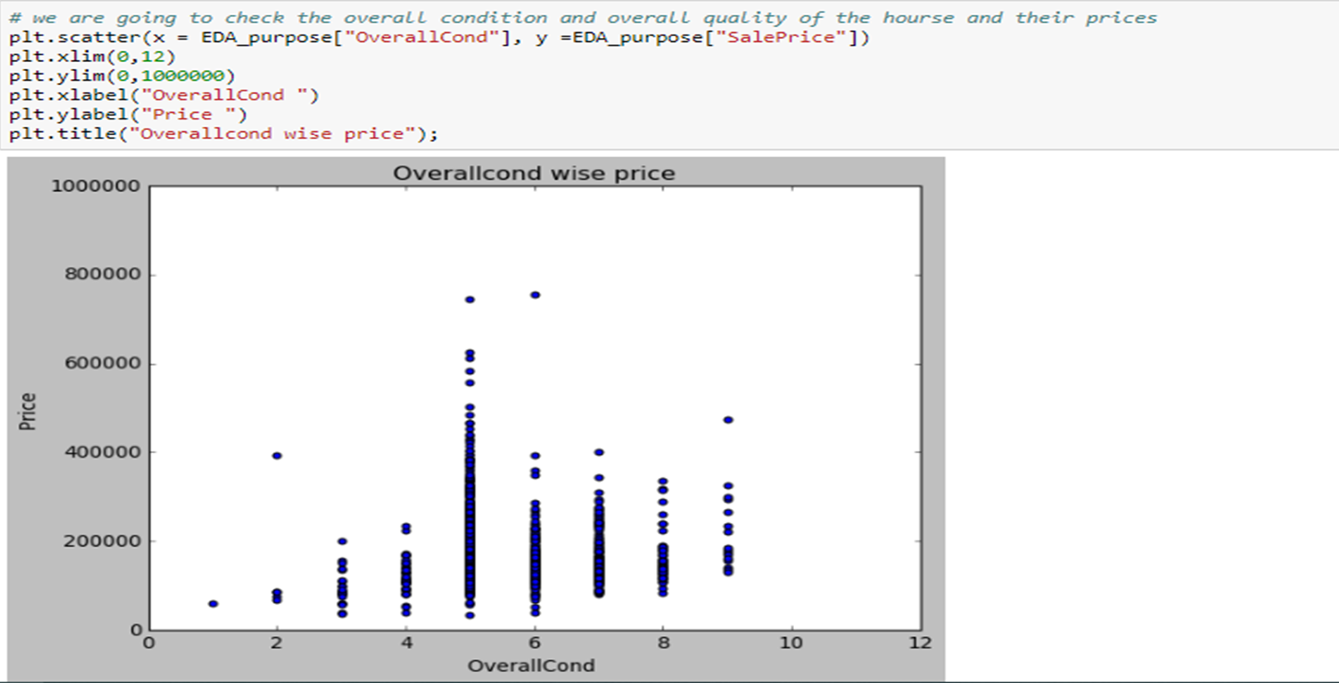
EDA Steps & Visualization – Overallcond
basis of the overall condition rating and Lot Area, property price is going up and down.

Slide 7
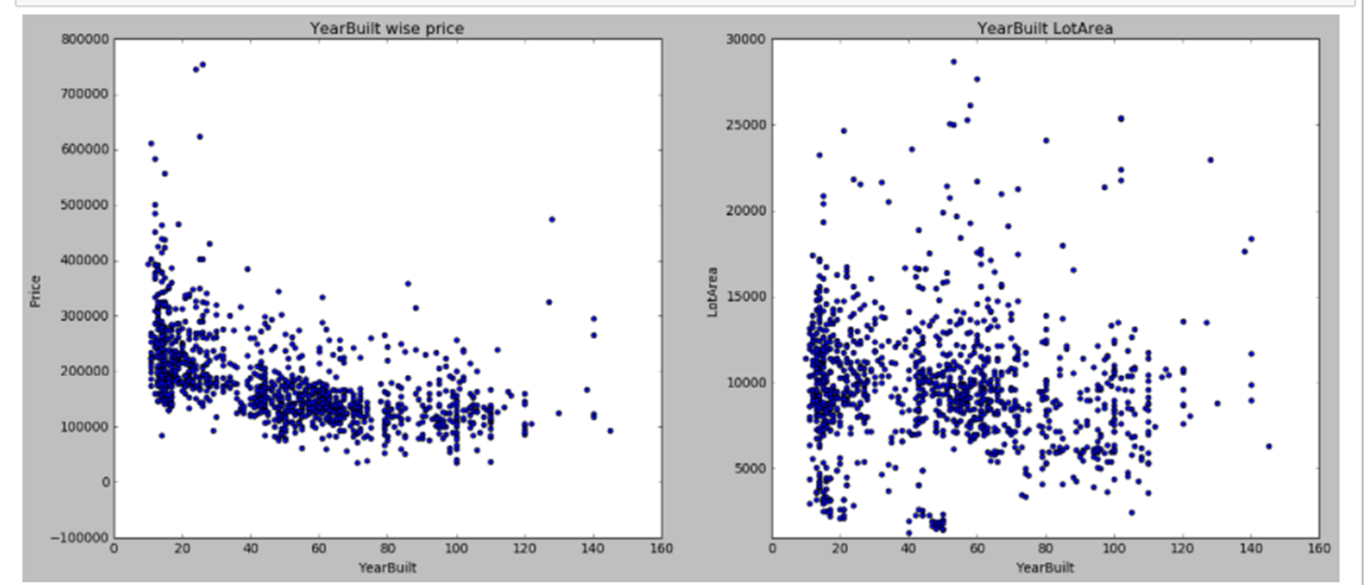
EDA Steps & Visualization – YearBuilt
majority of the house are 70 years old and their price fall under $400000, we can count that only 6 house and those are below 20 years and their price is between 6.5 to 8 LAKH majority of the property lot is below or equal to 15000 square feet.

Slide 8
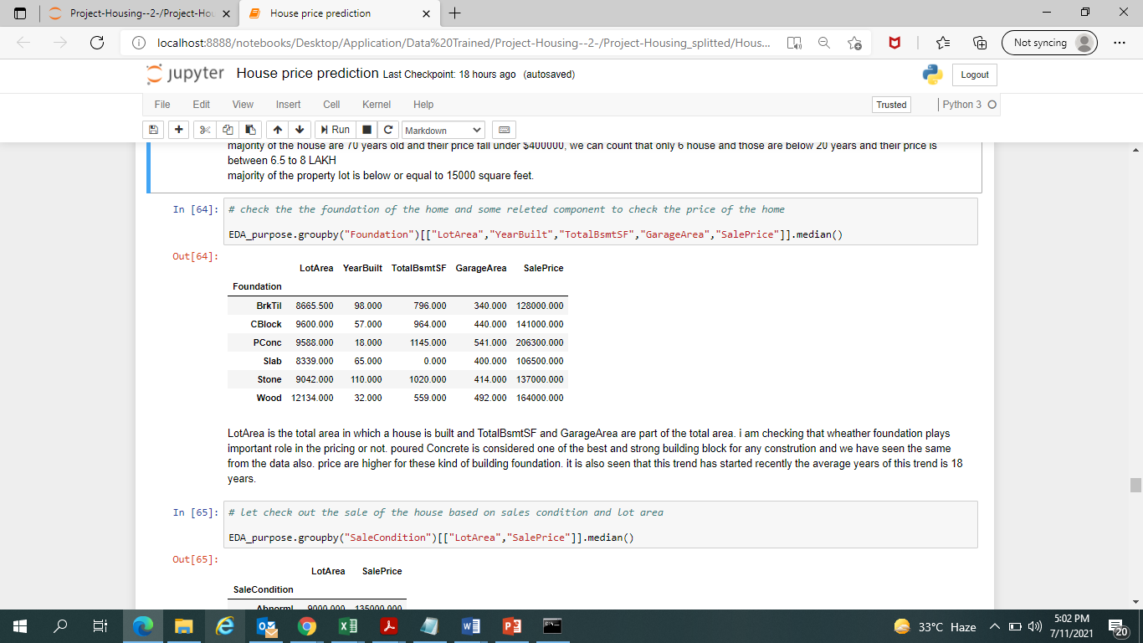
EDA Steps & Visualization – Foundation
LotArea is the total area in which a house is built and TotalBsmtSF and GarageArea are part of the total area. i am checking that whether foundation plays important role in the pricing or not. poured Concrete is considered one of the best and strong building block for any construction and we have seen the same from the data also. price are higher for these kind of building foundation. it is also seen that this trend has started recently the average years of this trend is 18 years.

Slide 9
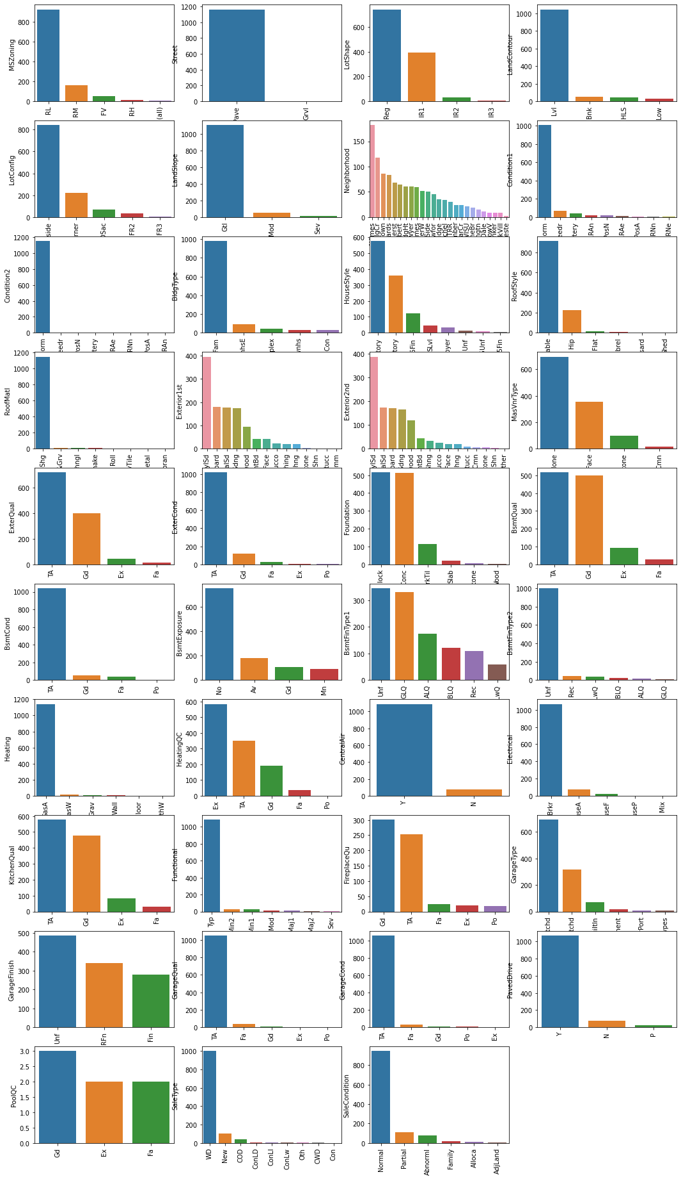
Assumption while Outlier treatment and other graph
Distribution plot on training numerical data point. we have Garagearea col which looks like normal distributed and rest are all skewed, we will correct the skewness

Slide 10
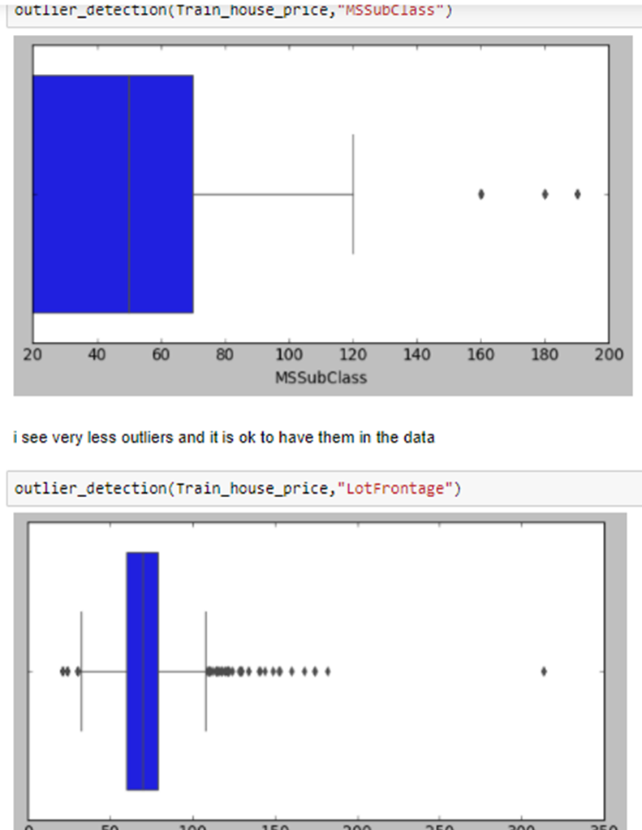
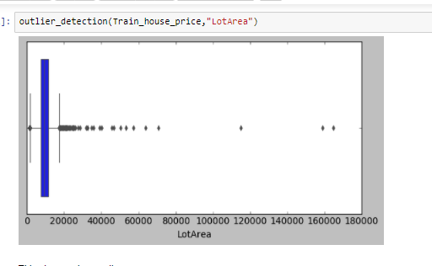
Assumption while Outlier treatment and other graph
I have seen couple of columns outlier status and i have found that a few of these columns have extreme values but those are very close of upper whisker and a few of the cols have more extreme values but looking at the nature of those cols it is possible to have them in the data because depends on area other things will vary. Thus I am not removing outlier but will do scaling and apply robust scaler to minimize the impact of outlier on the model

Slide 11
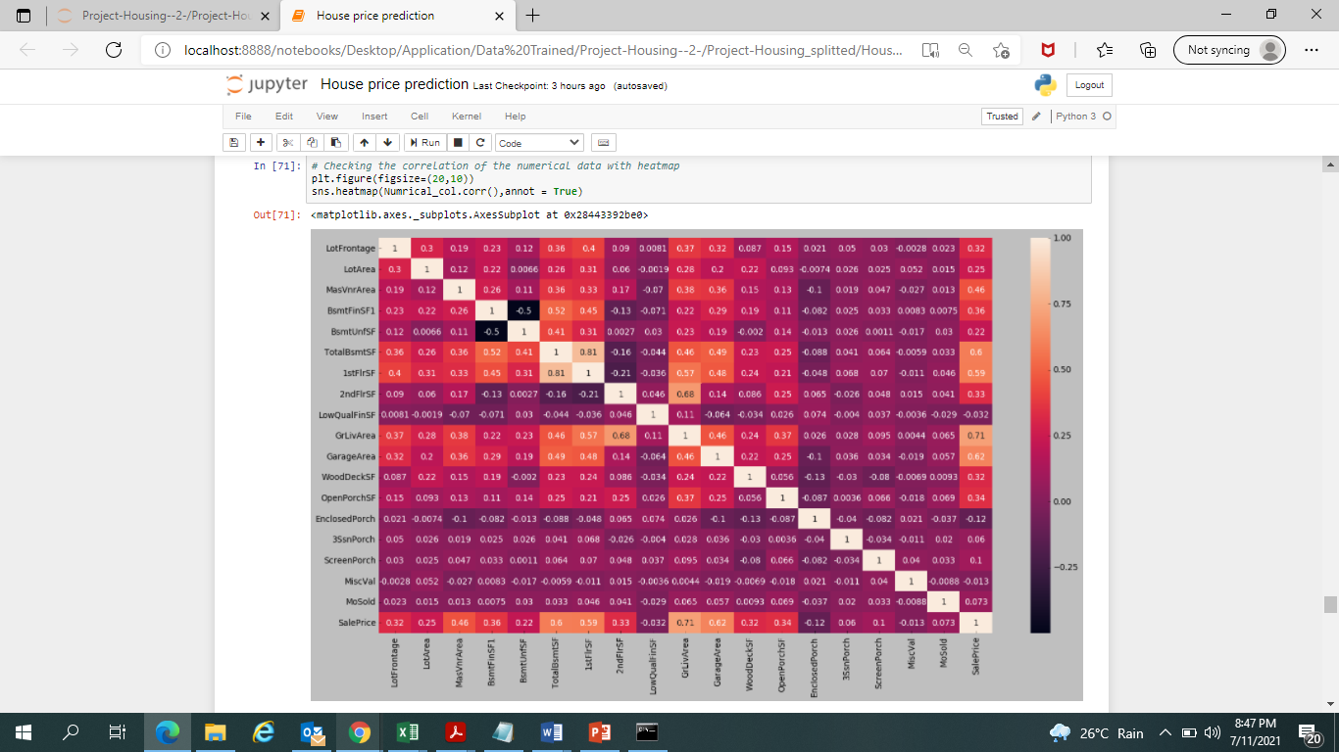
Correlation plot
I have checked the columns which are adding value to predict the sale price and remove those which arenot contibuting to predict the sales values much, so we can remove columns like are Lowqualfinsf,enclosedporch, 3ssnporch, mosold, miscval, screenporch.

Slide 12
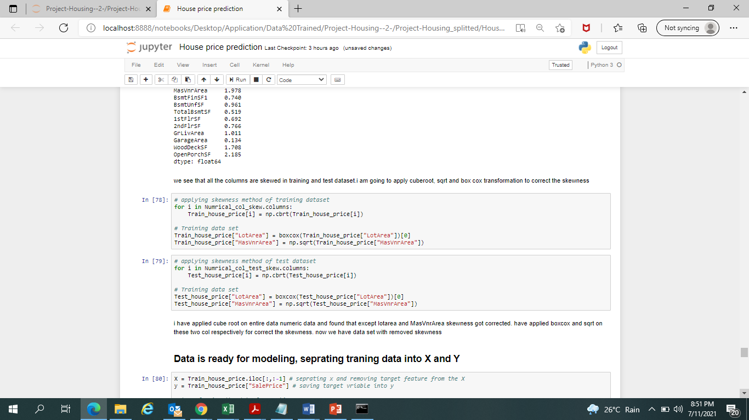
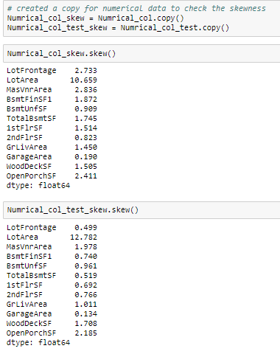
Skewness correction
Correction method
Skewness
We seen earlier that numerical columns are skewed so to correct that i have applied cube root on entire data numeric data and found that except lotarea and MasVnrArea skewness got corrected. have applied boxcox and sqrt on these two col respectively for correct the skewness. now we have data set with removed skewness

Slide 13
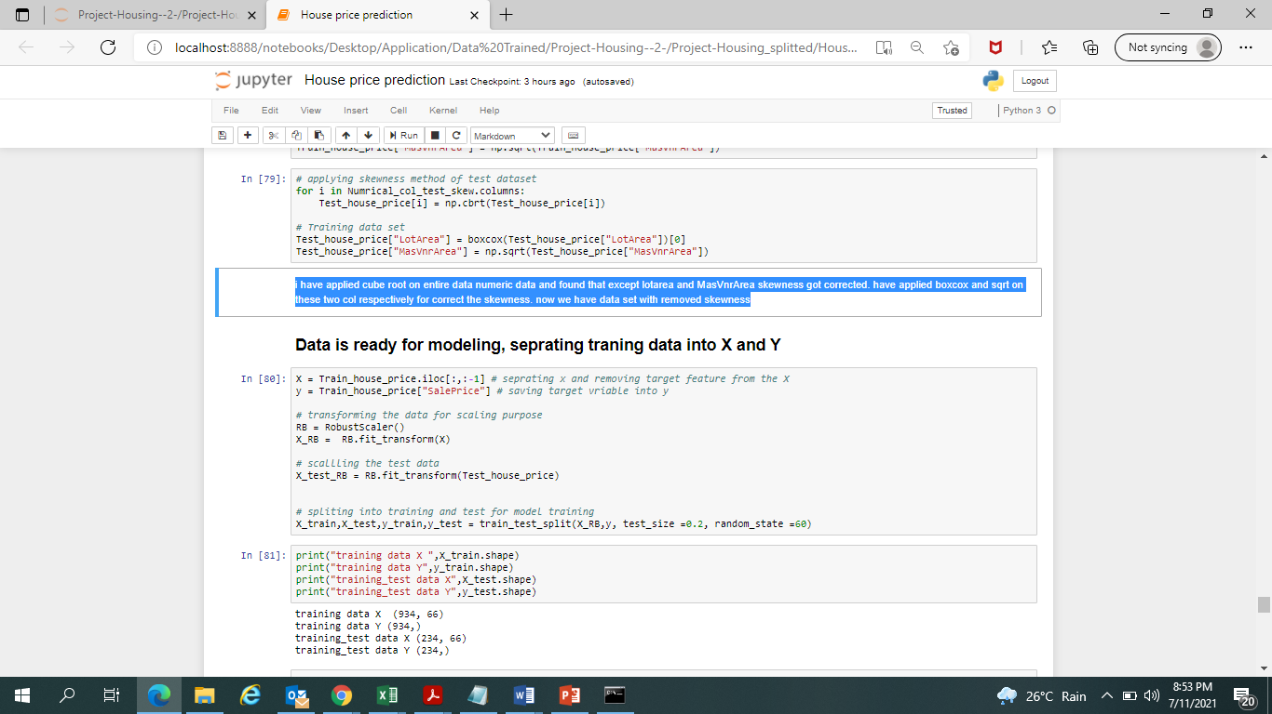
Modeling part
Data is ready for modeling, in this part data is being separated into X and y and further training and testing.
Since we have different scaled vales columns in the dataset. I have applied robust transformer to scale the data considering there are some outlier in the dataset and robust scaler is not effected by them
Checking the shape of the training and test data so ensure that separation happened and no error

Slide 14
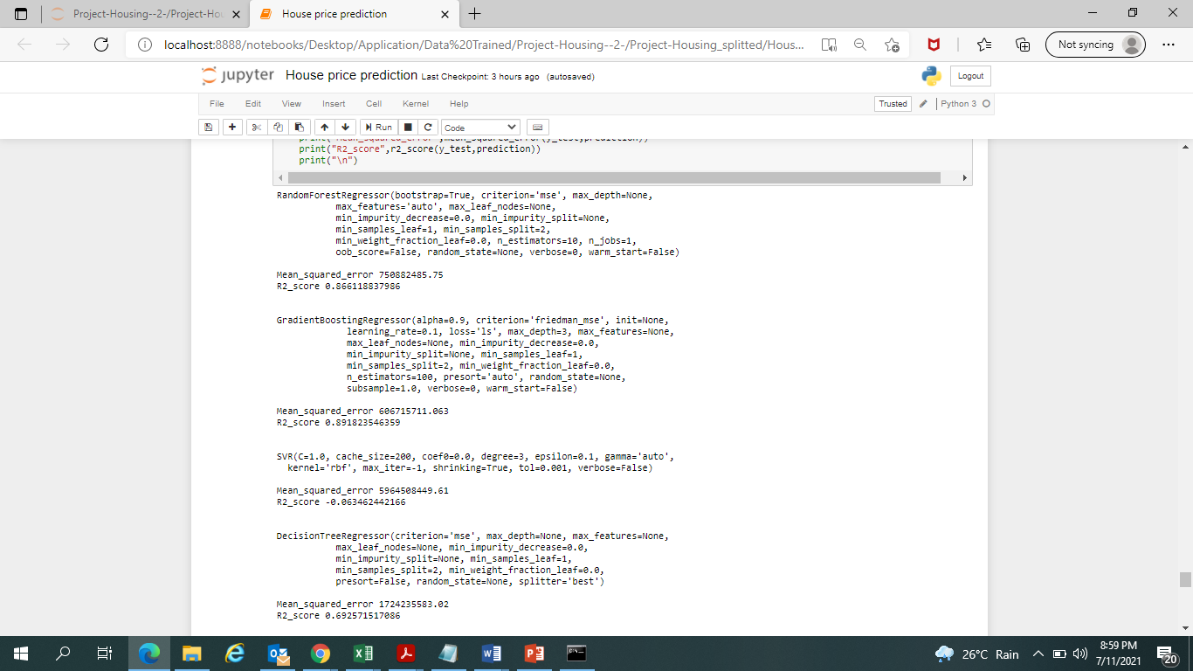
Machine learning algorithm

Slide 15
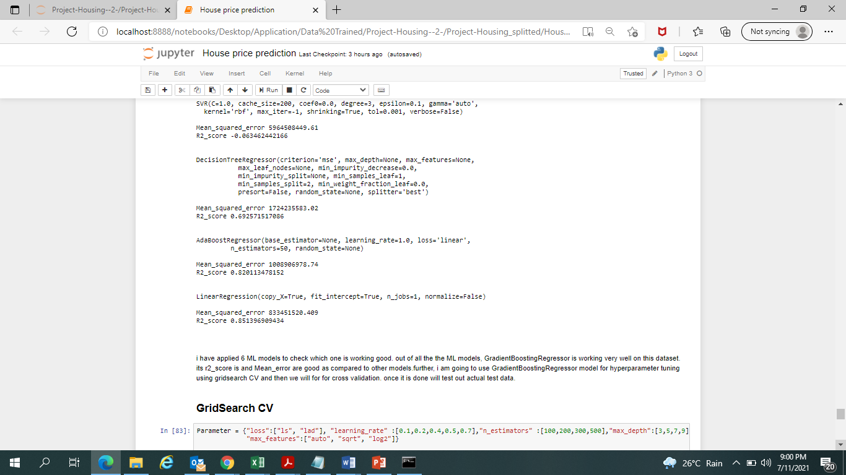
i have applied 6 ML models to check which one is working good. out of all the ML models, GradientBoostingRegressor is working very well on this dataset. its r2_score is and Mean_error are good as compared to other models.further, i am going to use GradientBoostingRegressor model for hyper parameter tuning using grid search CV and then we will for for cross validation. once it is done will test out actual test data

Slide 16
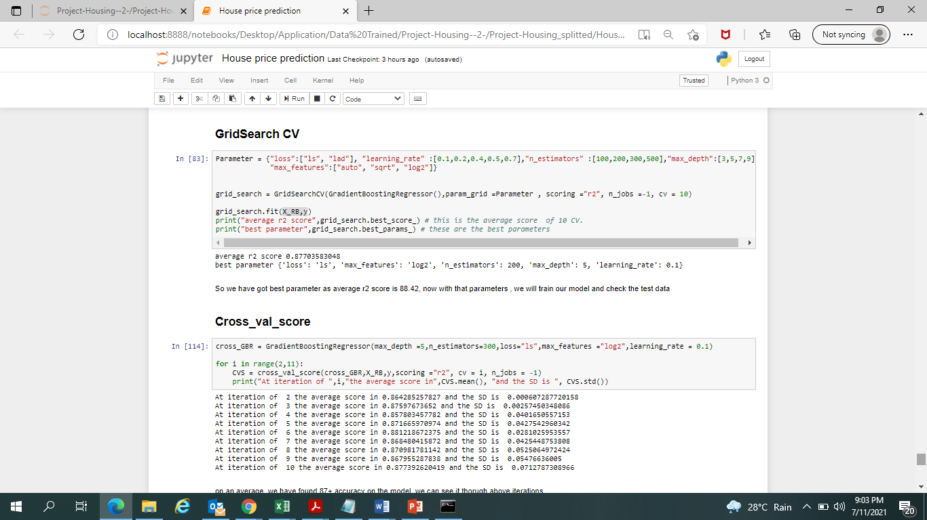
GridSearch & cross_val_score
I have selected Gradientboosting algorithm as the final one and training it further to find best parameters
So we have got best parameter and average r2 score is 87.70, now with these parameters , we will train our model and check the test data.
I have peformed cross_cal_score as well and on an average, we have found 87+ accuracy on the model.

Slide 17
Conclusion
we were given training and test csv file separately, training set has 1168 observation with 81 columns including target one. Test file has 80 columns as it doesn't have Target column. I found missing values in couple of columns, some columns missing value percentage was quite high. i took 20% threshold, columns which had 20% or above that missing value those were dropped and less than 20% missing value imputed with mode, median and respective col's value. i have checked categorical columns and found that one column had only one single value in it, have deleted them. have checked outlier as well, in maximum columns majority of values are near to the upper whisker and a few values were far. i have not removed them consider that the nature of property. some lot sizes are small and some are large thus i didn't remove them. all categorical columns are encoded by using cat.codes function. Skewness also get removed from the columns. Features which had high correlated were got deleted. features which were not adding values to the predicting sales were also removed from the data. While modeling the , dataset were scaled and then given to model. GradientBoostingRegressor is working well on the dataset and provide good r2 score and low MSE. i have selected this as final one and did hyper parameter tuning. average r2 score after Gridsearch CV is 88.44. at the last ML algorithm is trained on best parameter and tested on test data.

Slide 18
Thank you

